Slide 1
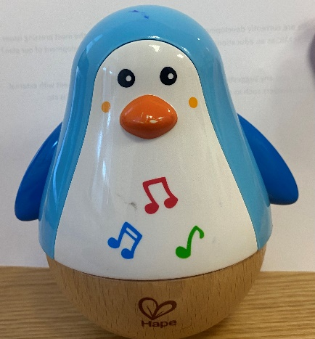
Wobble Bottom Toy
You and your engineering team will have to make a Wobble Bottom Toy from the suggested materials you are given!
What you need to do to complete the challenge
Design and create a toy that wobbles on its bottom from the craft materials you have available.
It must be made from a plastic egg that can be split into halves.
It must have enough plasticine inside to make it wobble back and forth and side to side.
You must decorate it either like a person or an animal of your choice.
Make sure to give a presentation on how you brought it to life and show the class how it works.
Challenge yourself even more and think of other products you could use as a base instead of a plastic egg.
Suggested Materials
Plastic Egg that splits in half
Plasticine
Craft Materials
Take a picture of your designs & tag us in your posts! Make Sure to use #STEPS and #EngineersWeek!
X: @MICStemCraft @EngineerIreland Instagram: @MICStemCraft @EngineerIreland

Slide 2
Balloon Rocket
You and your engineering team will have to make a balloon rocket from the suggested materials you are given!
What you need to do to complete the challenge
Have a look at some designs for ideas then plan and draw your diagram. Make sure you label the materials you will use to make each part.
The rocket must be powered by air. It must travel at least half way across the classroom. It must travel on a string that stretches across the class
You can only use the suggested materials.
Give a presentation to the class as to why you picked this design.
Challenge yourself even further and try to make your rocket go the farthest, and make your rocket as colorful as you want.
Suggested Materials
Cardboard Tube
Paper
String
Balloon
Straw
Sellotape
Take a picture of your designs & tag us in your posts! Make Sure to use #STEPS and #EngineersWeek!
X: @MICStemCraft @EngineerIreland Instagram: @MICStemCraft @EngineerIreland

Slide 3
Zip Line
You and your engineering team will have to make a Zip Line from the suggested materials you are given!
What you need to do to complete the challenge
First you must figure out how to create a zip line with your recycled materials.
Plan and draw a diagram of your design, make sure to label what each piece is for.
Collect all of the recycled materials you need.
The fishing line used for this challenge must be four ruler-lengths long.
To complete the challenge your zip line must be able to carry 5 marbles from the top of the zip line to the bottom safely.
At the end you will give a presentation on how you made your zip line and how it is in action.
Suggested Materials
Fishing Line or Thin Twine
Sellotape
Paper Clips
Five Marbles
Recycled Materials
Meter Stick
Take a picture of your designs & tag us in your posts! Make Sure to use #STEPS and #EngineersWeek!
X: @MICStemCraft @EngineerIreland Instagram: @MICStemCraft @EngineerIreland

